Slide 1

Welcome to
Introductory R Training Course
Delivered to:
The Food and Drug Administration
July 19 - 20, 2021

Slide 2

Introduction

Slide 3

Pre-course assessment
Statistics
SQL
Spark
Shiny
RStudio
R
Quality Metrics
Count
Programming
16
Topic
Prescriptive Analytics
12
Predicitive Analytics
8
Notebooks
NLP
4
ggplot
0
Descriptive Analytics
Deep Learning
Data Visualization
Data Cleaning
None
Beginner
Competent
Proficient
Expert
Proficiency

Slide 4
Course structure
This is a 2-day course that will take place from 9AM to 4PM EDT
There are 10-minute breaks each hour and a 1-hour break for lunch
The course is broken down into a series of modules, each with their own learning objectives and materials
The modules are instructor lead, and the training will leverage a combination of presentations, live coding, hands-on labs, and at least one anonymous quiz
If there are questions during the course, please enter them into the chat

Slide 5

Course Learning Objectives
By the end of this course, you will be able to:
Understand enough R programming sufficient for working on the labs and most basic data analytics tasks
Get familiar with notebooks in RStudio (knittr)
Use R Markdown
Import a variety of data formats into R (e.g. JSON, CSV*, XPT*, XLS) (Stretch goal - API)
Clean and pre-process data in preparation for analysis (quality control check)
Merge and transform data from multiple data sources
Interact with data using shiny (time permitting)

Slide 6
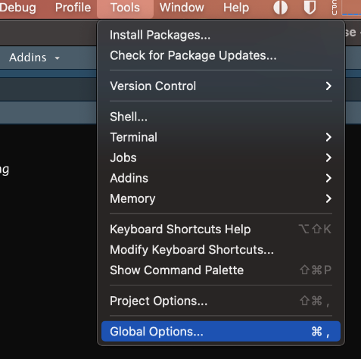
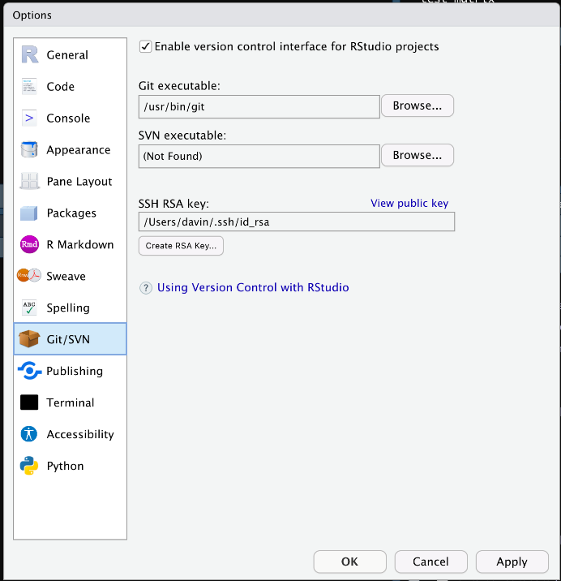
Course precheck
1. Global Options
Did everyone complete the course prework?
Open up RStudio
Verify that RStudio can find Git
2. Verify Git

Slide 7
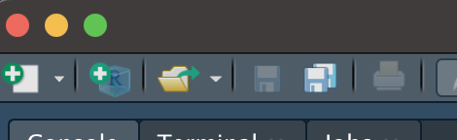
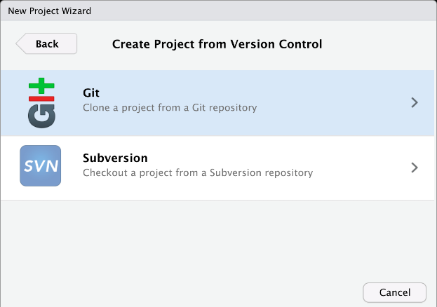
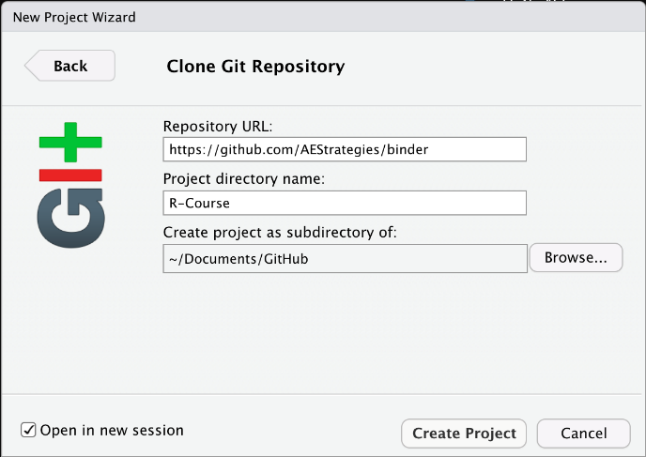
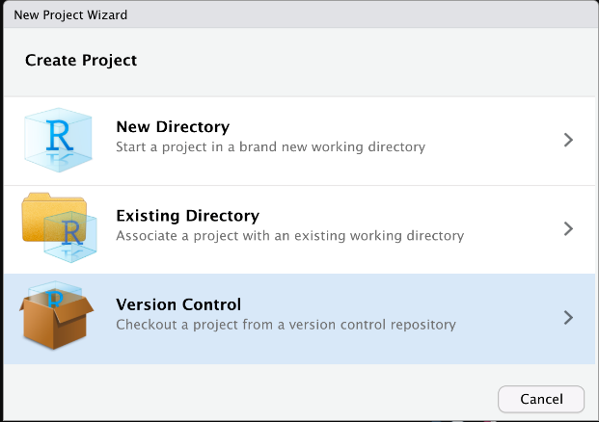
Course media
GitHub URL:
https://github.com/AEStrategies/R-DataViz
1. Create New Project
3. Choose Git
4. Create The Project
2. Choose Version Control

Slide 8
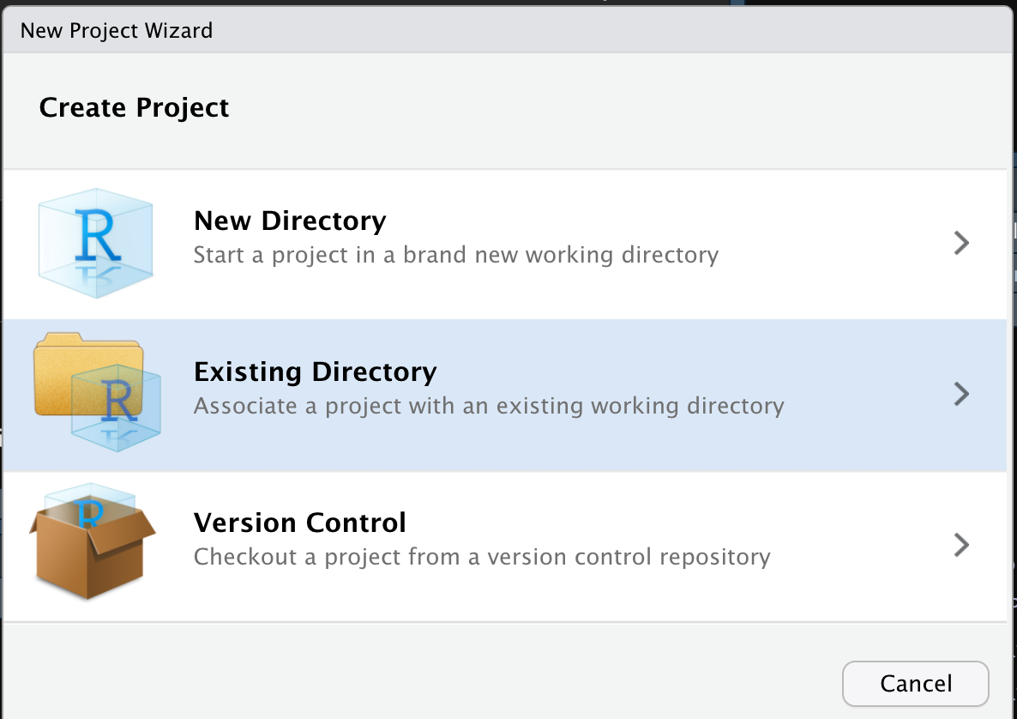
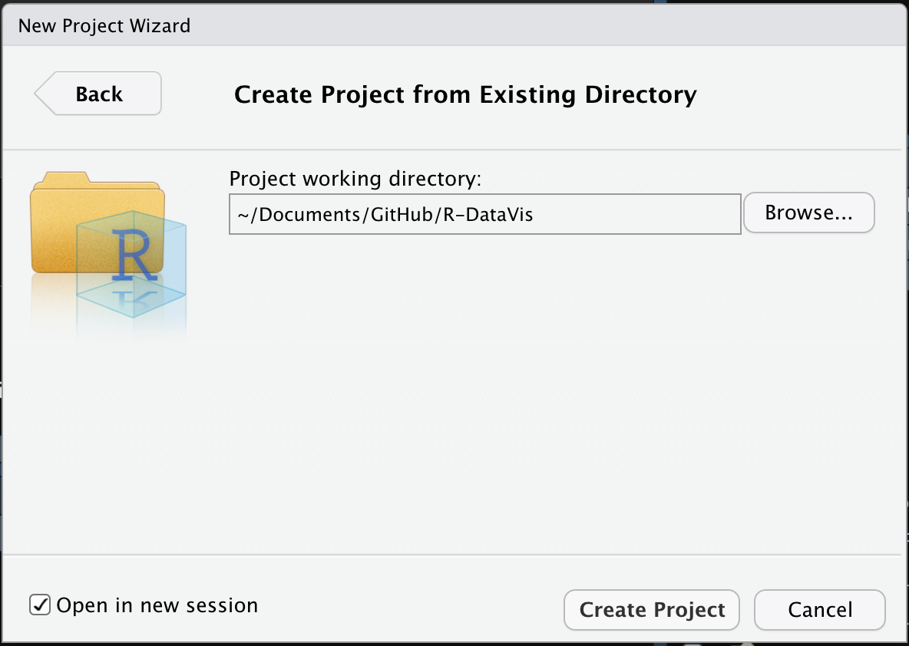
Course media
GitHub URL:
https://github.com/AEStrategies/R-DataVis/archive/refs/heads/main.zip
1. Create New Project
2. Choose Existing Directory
3. Choose Extracted Folder
And
Create Project

Slide 9
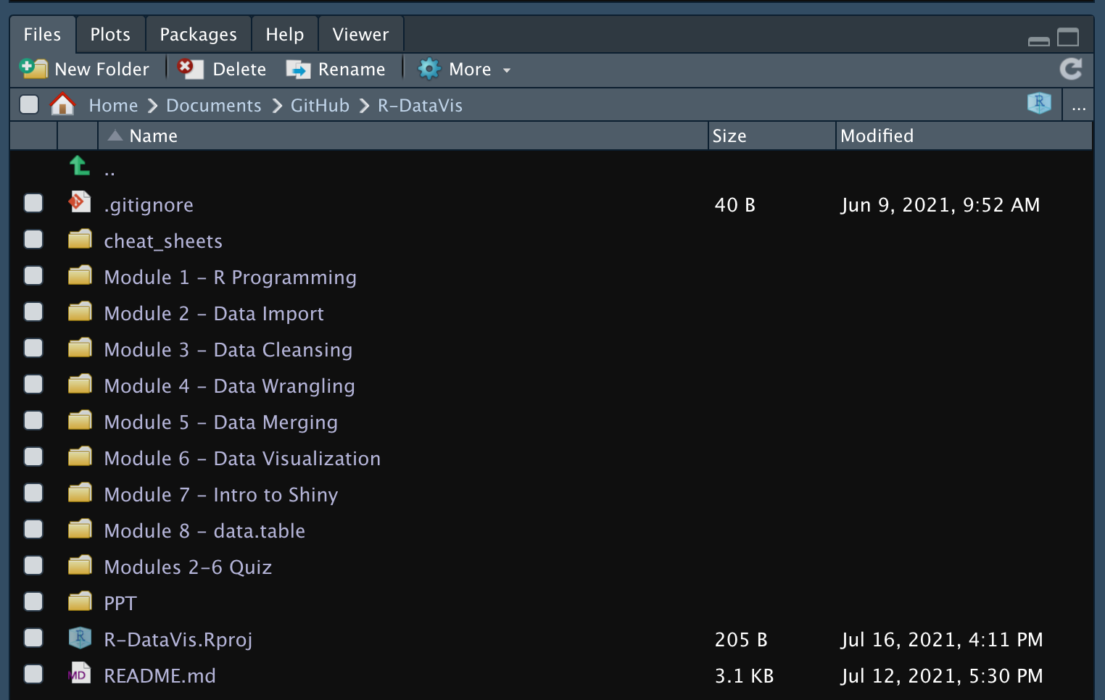
Course media
Project Files

Slide 10

Agenda
Basic R programming
Importing data formats
Clean and process data
Introduction to dplyr
Data merging
Visualize data with ggplot2
Shiny interactive visualizations (time permitting)

Slide 11
Welcome to
Basic R Programming

Slide 12
Module Learning Objectives
By the end of this module, you will be able to:
Understand enough R programming sufficient for working on the labs and most basic data analytics tasks
Get familiar with notebooks in RStudio (knittr)
Use rmarkdown

Slide 13

What R Is
Free
The first official release came in 1995
R is an extended implementation of the S programming language
Designed for statistics and graphics
Easy to
learn and use
Designed for statistics
Open Source
R
Programming
As powerful as your computer will allow
Capable of
end-to-end
data processing
Conducive for web-applications
Supported by a huge community

Slide 14
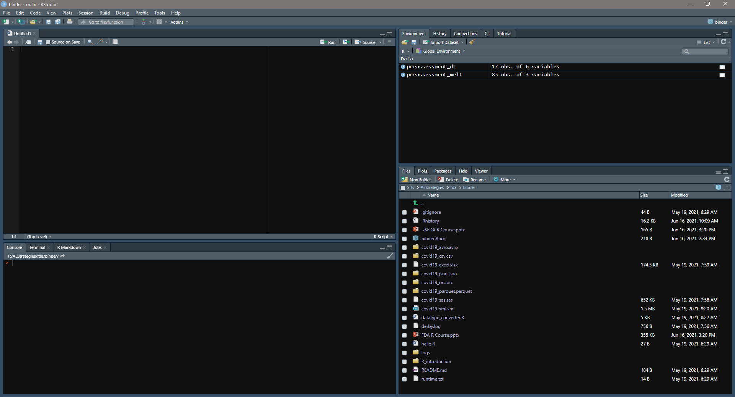
RStudio Layout
Environment, Git, etc.
Scripts, Notebooks
Files, Plots,
Help, etc.
Console, Terminal, etc

Slide 15
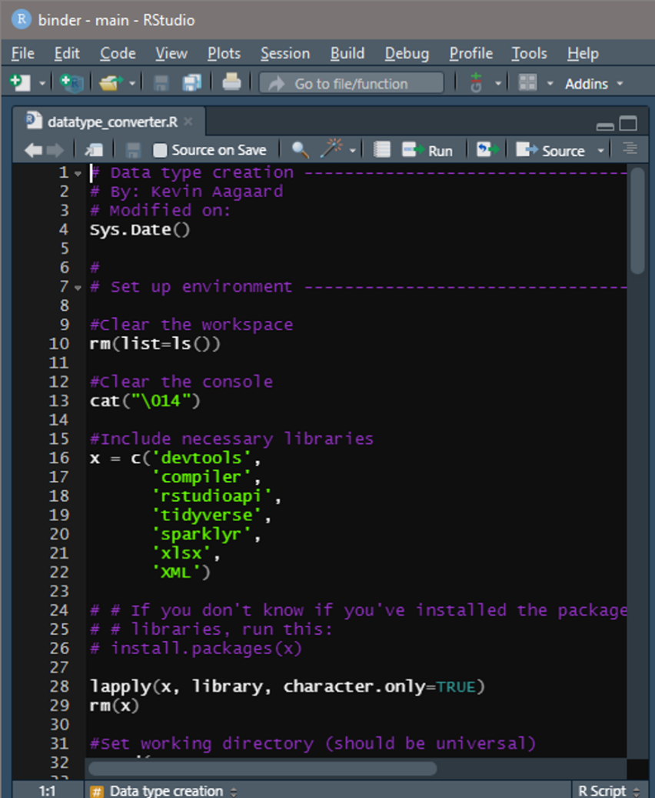
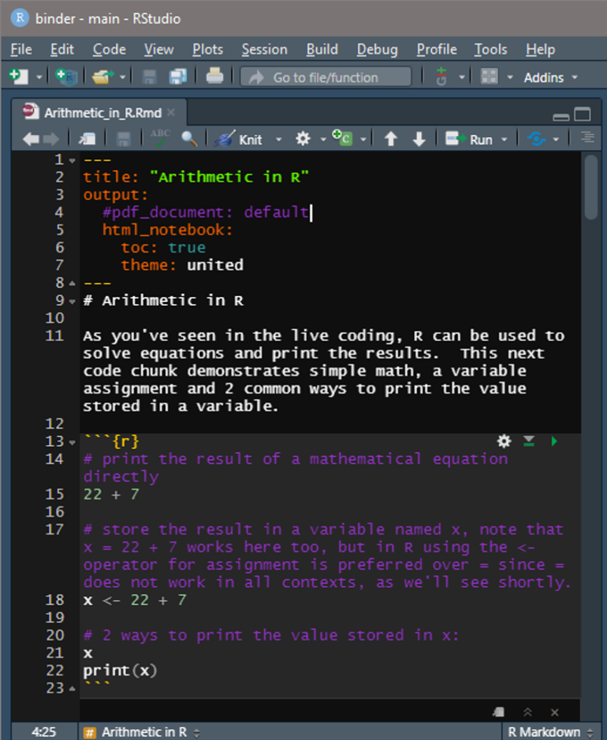
Scripts Versus Notebooks
*.R
*.Rmd

Slide 16
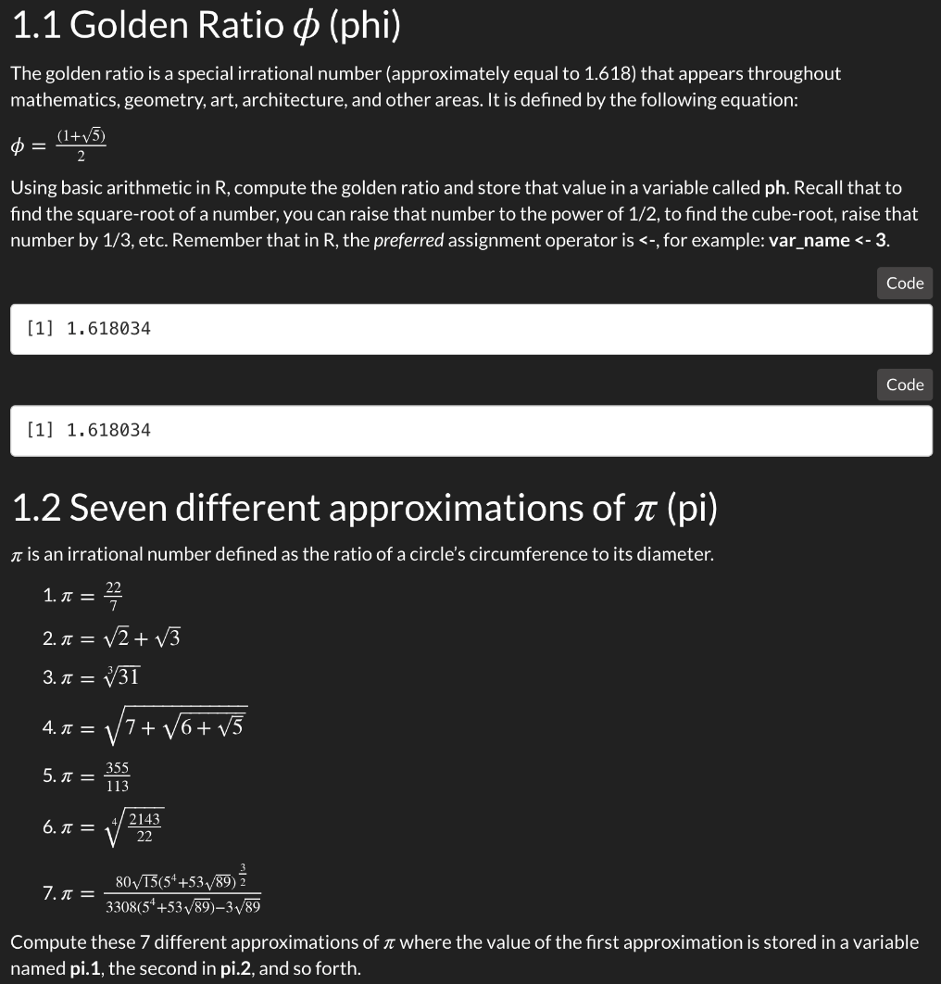
Lab Basic Arithmetic in R
Lab Goals:
Navigating RStudio
Basic mathematical calculations in R
Variable assignments
Inspect variables in the global environment
Clean variables in the global environment
Output formatting using sprintf()
Code comments
rmarkdown
Get help on functions
Knit the notebook into HTML for publishing

Slide 17
Object Types
Data Type
Examples
Numeric/float
0.17
Integer
1, 10, 100
Character/string
“I love R”
Factor
“group 1”, “group 2”, “group 3”
Logical/Boolean
TRUE/FALSE
Date
07/19/2021
Vector
Array
Lists
Matrix
Data.frame

Slide 18
Logical Operations Diagrams (for, while loops; if/else statements)
Start
Start
Start
For each item
in the sequence
Enter while loop
Yes
Condition
true?
No
Last element?
Yes
Test
Expression
False
Execute code in if block
Execute code in else block
No
Exit
True
For loop body
Body of while
Execute code outside if block
Exit

Slide 19
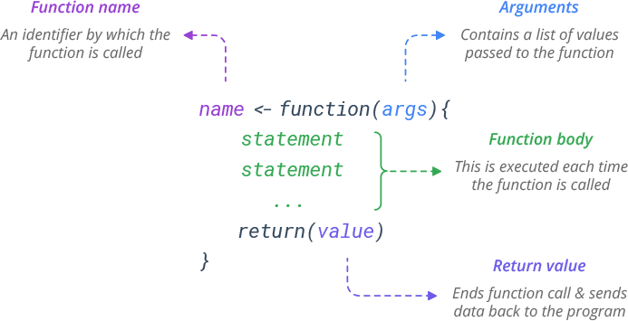
Functions

Slide 20
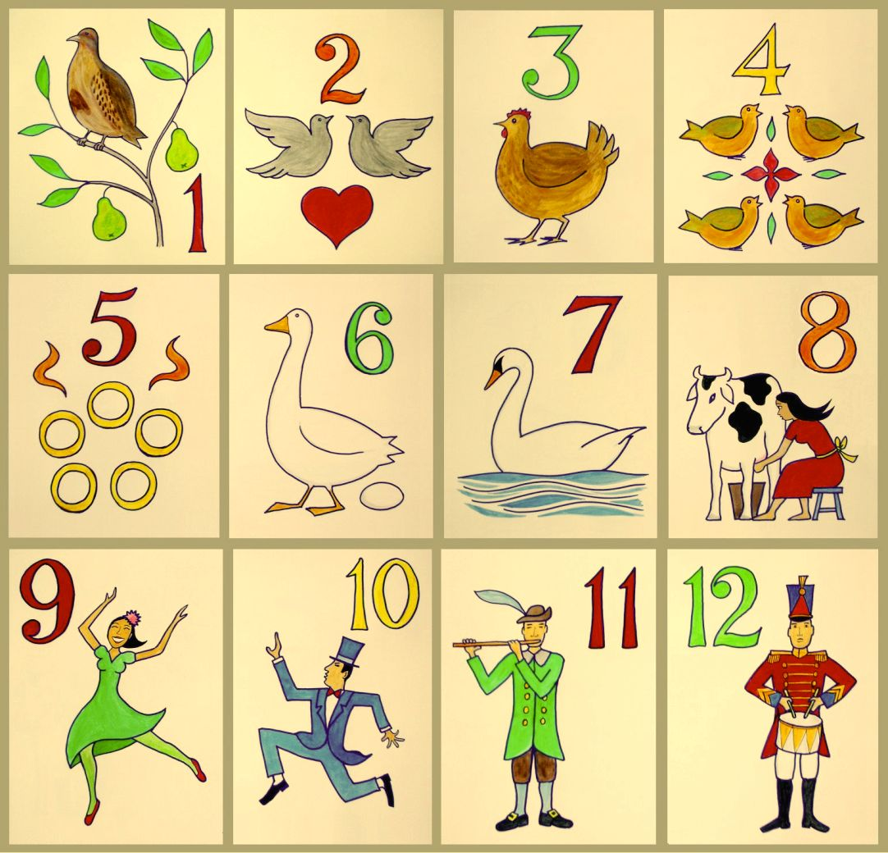
Lab twelvetide
Lab Goals:
Distinguish between an R script and R notebook
Create vectors
Create data frames
Perform vector operations
Solve the time-honored gift count problem
Filter data frames
Plot data frames
Discover what happens on day 13

Slide 21

Review and practice
Cheatsheets: Base R

Slide 22
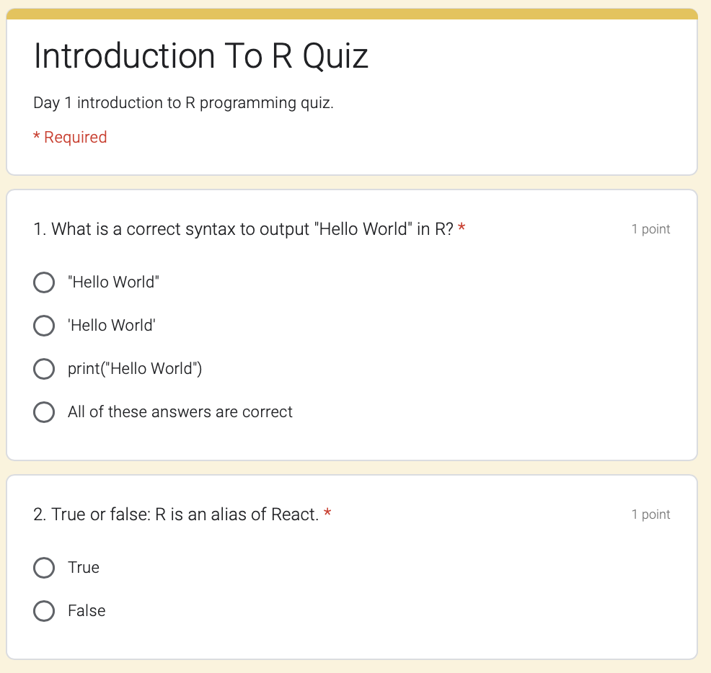
Quiz R Programming Knowledge Check
Anonymous
22 questions
How well are we doing?

Slide 23
Agenda
Basic programming
Importing data formats
Clean and process data
Introduction to dplyr
Data merging
Visualize data with ggplot2
Shiny interactive visualizations (time permitting)

Slide 24
Welcome to
Importing Data Formats in R

Slide 25
Module Learning Objectives
By the end of this module, you will be able to:
Import the following data formats into an R data frame:
CSV
JSON
XLXS
SAS
XML
ORC
AVRO
PARQUET

Slide 26












Importing Data
CSV
XLSX
TXT
XML
Data Frame
PARQUET
SAS
ORC
AVRO

Slide 27
Importing Data
Name
Total
Total %
# Attend
$ Cost
Sample 1
15
73%
63
$1,587
Sample 2
21
87%
89
$2,876
Sample 3
-
-
-
-

Slide 28
Agenda
Basic programming
Importing data formats
Clean and process data
Introduction to dplyr
Data merging
Visualize data with ggplot2
Shiny interactive visualizations (time permitting)

Slide 29
Welcome to
Cleaning and Processing Data in R

Slide 30
Module Learning Objectives
By the end of this module, you will be able to:
Compute basic data metrics
Find missing data
Filter out and impute missing data

Slide 31
Cleaning Data
Number
Cost
Employee
Type
Available
1
$19.10
Pat
Front
Yes
Examine the data’s structure [str()]
2
$5.40
Bob
Back
Yes
Remove, interpolate, or set “missing” data
3
$7.30
Tina
Front
Yes
Rename nonsensical or uninterpretable columns
4
NA
Bob
Front
No
Remove unnecessary columns
5
$2.18
Tina
Front
Yes
6
$105.47
Pat
Back
No
Avoid copying in R if you can avoid it, R holds copies in memory!
“sales_data_cleaned.csv”
7
$657.32
Tina
Back
No
Save modified datasets, with meaningful names.
8
NA
Bob
Front
Yes
9
$981.02
Jill
Back
No
10
$5.06
Jill
Back
No
11
$52.43
Jill
Back
No

Slide 32
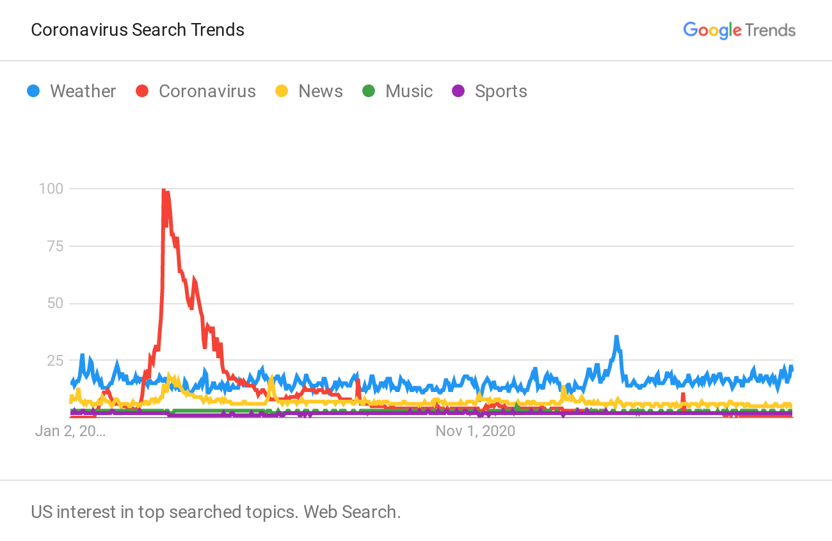

Unstructured Data
Natural Language data, like internet searches or social media posts.
01 January 1970
January 1st, 1970
1/1/1970
01/01/1970
01-01-1970
01/01/70

Slide 33
Agenda
Basic programming
Importing data formats
Clean and process data
Introduction to dplyr
Data merging
Visualize data with ggplot2
Shiny interactive visualizations (time permitting)

Slide 34
Welcome to
Data Wrangling with dplyr

Slide 35
Module Learning Objectives
By the end of this module, you will be able to:
Effectively use R’s pipe %>% syntax
Learn dplyr's grammar for data manipulation using the following functions:
filter
select
mutate
arrange
summarize

Slide 36
Introduction to dplyr
Cost (hds)
$0.191
$0.054
$0.073
NA
$0.0218
$1.0547
$6.5732
NA
$9.8102
$0.0506
$0.5243
Employee | Type
Pat | Front
Bob | Back
Tina | Front
Bob | Front
Tina | Front
Pat | Back
Tina | Back
Bob | Front
Jill | Back
Jill | Back
Jill | Back
Cost | Employee | Type | Available
$19.10 | Pat | Front | Yes
$5.40 | Bob | Back | Yes
$7.30 | Tina | Front | Yes
NA | Bob | Front | No
$2.18 | Tina | Front | Yes
$105.47 | Pat | Back | No
$657.32 | Tina | Back | No
NA | Bob | Front | Yes
$981.02 | Jill | Back | No
$5.06 | Jill | Back | No
$52.43 | Jill | Back | No
Cost
$19.10
$5.40
$7.30
NA
$2.18
$105.47
$657.32
NA
$981.02
$5.06
$52.43
Available
Yes
Yes
Yes
No
Yes
No
No
Yes
No
No
No
Mean = $203.92
Filter the data: filter()
Establish groups: group_by()
Select a subset: select()
Apply functions: mutate()
Arrange groups: arrange()
Make summarizations: summarise()

Slide 37
Introduction to dplyr
Using the dataset “data”,
filter the data according to a logical argument, then
group the data by the unique categories in a column, then
“mutate” the data by adding a new column, then
arrange the columns in a specific order, then
summarise specific columns of the data, and finally
select a specific column
data %>%
filter() %>%
group_by() %>%
mutate() %>%
arrange() %>%
summarise() %>%
select()

Slide 38
Review and practice
Cheatsheets:
Data Transformation

Slide 39
Agenda
Basic programming
Importing data formats
Clean and process data
Introduction to dplyr
Data merging
Visualize data with ggplot2
Shiny interactive visualizations (time permitting)

Slide 40
Welcome to
Data Merging in R

Slide 41
Module Learning Objectives
By the end of this module, you will be able to:
Learn the 4 basic data joins:
Left join
Right join
Inner join
Outer join
Learn how to accomplish these basic joins in R

Slide 42
Transforming Data
merge()
cbind()
rbind()
Add Columns
Add Rows
Combine Data Frames

Slide 43

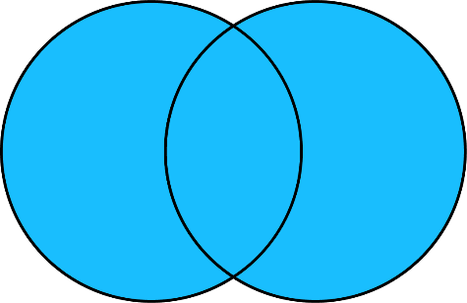


Merging Data
Inner join
Full outer join
D1
D2
D1
D2
all = FALSE
all = TRUE
Left outer join
Right outer join
D1
D2
D1
D2
all.D1 = TRUE
all.D2 = TRUE

Slide 44
Agenda
Basic programming
Importing data formats
Clean and process data
Introduction to dplyr
Data merging
Visualize data with ggplot2
Shiny interactive visualizations (time permitting)

Slide 45
Welcome to
Data Visualization with ggplot2

Slide 46
Module Learning Objectives
By the end of this module, you will be able to:
Learn the Grammar of Graphics (the "gg" in ggplot2)
Be Familiar with many common graphs created with ggplot2:
scatter plot
line graph
bar graph
histogram
tree map
heat map
box plot
Learn the best graph to use for various common use-cases

Slide 47
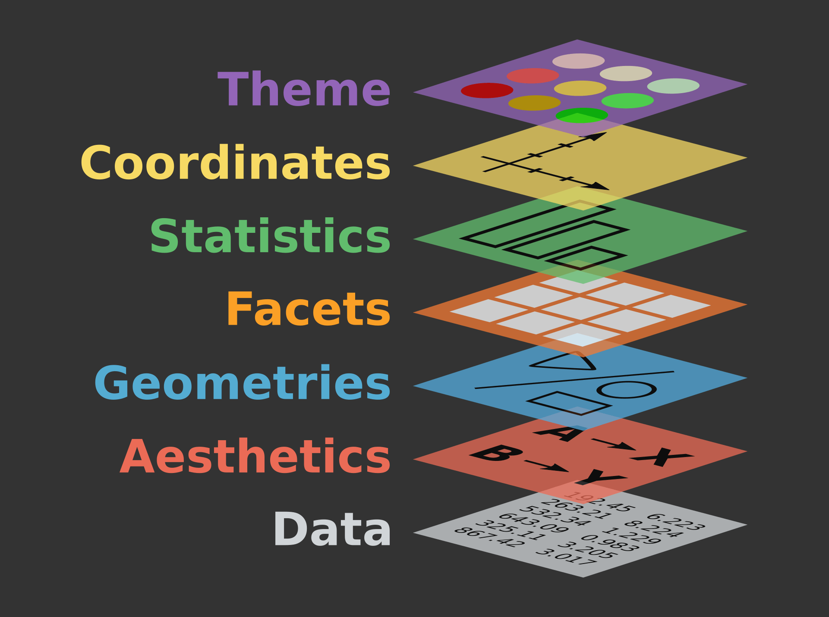
Visualizing Data with ggplot2
Grammar of Graphics

Slide 48
Visualizing Data with ggplot2
Using the dataset “target_df”
map these variables to the axis and color aesthetics, then
define objects in graph, then
split into subsets/panels, then
transform the data, then
flip the axes, and finally
set the color and design theme
ggplot(data = target_df,
aes(x = x_axis_col,
y = y_axis_col,
col = color_grouping_col)) +
geom_point() +
facet_wrap(vars(facet_group_col)) +
stat_summary() +
coord_flip() +
theme(legend.text = element_text(face = “bold”)

Slide 49
Visualizing Data with ggplot2
Cheatsheets:
Data Visualization

Slide 50
Agenda
Basic programming
Importing data formats
Clean and process data
Introduction to dplyr
Data merging
Visualize data with ggplot2
Shiny interactive visualizations (time permitting)

Slide 51
Welcome to
Interactive Visualizations with shiny

Slide 52
Module Learning Objectives
By the end of this module, you will be able to:
Know the anatomy of a shiny interactive application
Know the benefits of reactive visualizations
Browse RStudio’s gallery of shiny visualizations to incorporate into your own data visualization project

Slide 53
Visualizing Data with shiny
ui.R
server.R
Code for the web page
(User Interface)
Code for the machine running R
(server)

Slide 54
Visualizing Data with shiny
Cheatsheets:
Data Visualization

Slide 55
Wrap Up
Final details:
Stay in touch with us
End of course surveys
Thank You FDA!

Slide 56



Before you go…
please take a few moments to complete
the survey.
Check your email for the link.
Thank you!!

